Slide 1
Statistical Testing

Slide 2
Typical Data Science Cycle
Data Collection
Business Insights & Understanding
Data Understanding
Model Building & Evaluation
Data Pre-Processing

Slide 3
Content
Introduction of Concepts Used in Hypothesis Testing
Probability and Probability Distribution
Type of statistics
Central Limit Theorem
Confidence interval

Slide 4
Content
2. Hypothesis Testing Introduction and Its Type
3. Framework of Hypothesis Testing and Detailed Description
Z test
T test
F test
Chi Square test
ANOVA
4. Examples
5. Errors

Slide 5
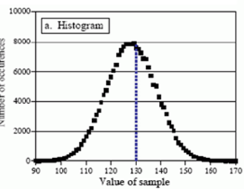
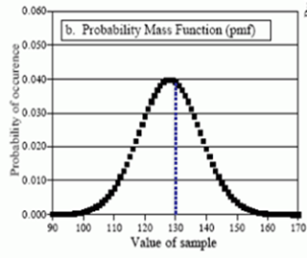
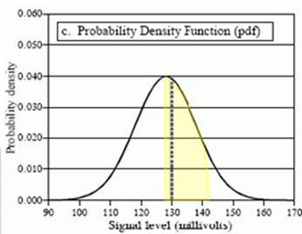
Probability Distribution
Histogram
PMF
PDF
( Discrete Probability Distribution)
( Continuous probability Distribution)

Slide 6
Probability Distribution
Example of continuous probability distribution
Normal Distribution
Student’s T probability Distribution
Chi square Distribution
F - Distribution

Slide 7
Type of statistics

Slide 8
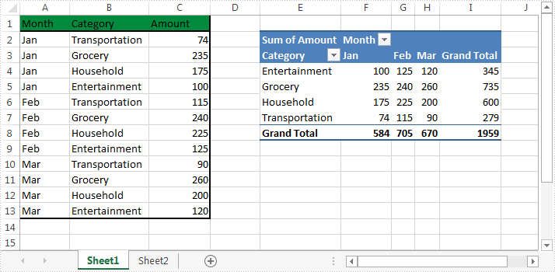
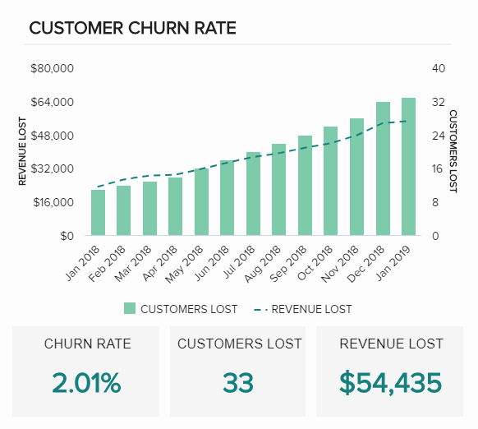
Types of Statistics
Descriptive Statistics is concerned with Data Summarization, Graphs/Charts, and Tables
It includes mean, median , mode, frequency, dispersion/variation etc

Slide 9
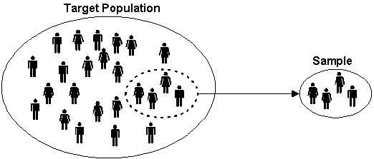
Types of Statistics
Inferential Statistics Data gathered from a sample and the statistics generated to reach conclusions about the population from which the sample is taken.
It is a method used to talk about a Population Parameter from a Sample.
It allows one to come to reasonable assumptions about the larger population based on a sample’s characteristics.
E.g. Z score, t score, F - statistics

Slide 10
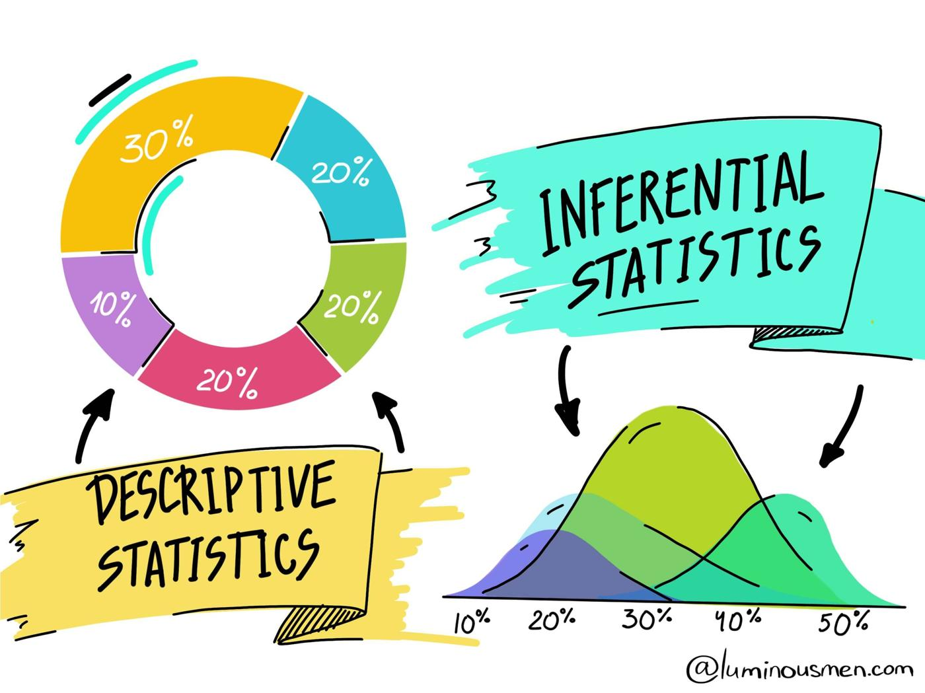
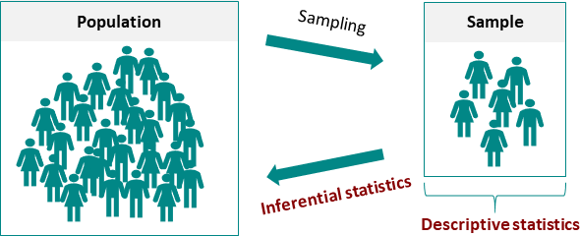
Types of Statistics

Slide 11
Sampling Distribution of Means

Slide 12
Sampling Distribution of Means
Sampling is a method of selecting units of analysis such as households, people, consumers, companies etc from a population (universe) of interest to a manager.
Instead of taking complete population into study (census) ,
we do sampling procedure to save time and money.
A statistic is an estimate based on sample data to draw inferences about a population characteristic of interest called the parameter (WE HAVE ALREADY SEEN IT)

Slide 13
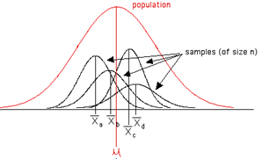
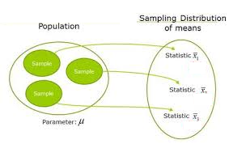
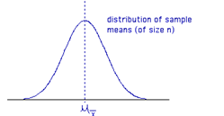
Sampling Distribution of Means
The sampling distribution of means is what you get if you consider all possible samples of size n taken from the same population and form a distribution of their means.
If n independent random samples drawn from a Normal Population with Mean = µ and Standard Deviation = σ , the means will follow a normal distribution with same mean (µ) and 1/n of variance (σ^2).

Slide 14
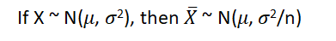
Sampling Distribution of Means
Central Limit Theorem
Irrespective of the shape of the distribution of the original population, the sampling distribution of the mean will approach a normal distribution as the size of the sample increases and becomes large.
As sample size goes large and number of buckets are high, the means will follow a normal distribution with same mean (µ) and 1/n of variance (σ^2).
A thumb rule based on experience says a sample size of 30 and above is considered large.

Slide 15
Confidence Interval

Slide 16
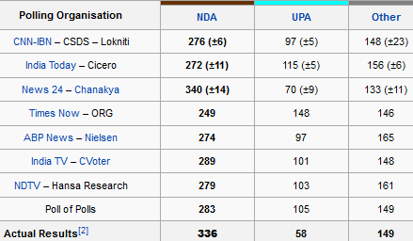
Confidence Interval
What is this?
Why is it not here?

Slide 17
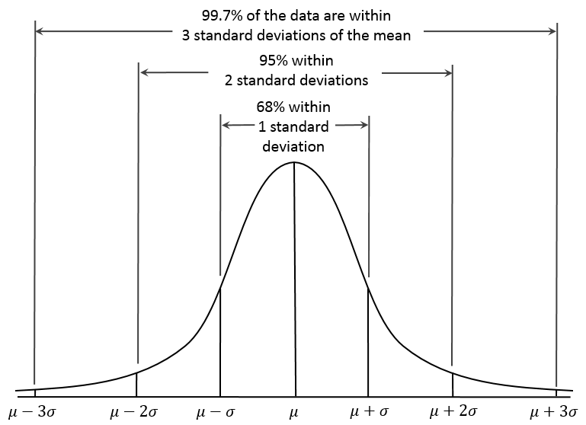
Normal Distribution Components
The Standard Normal curve has mean μ = 0 and standard deviation σ =1
In an Standard Normal Distribution : -
Mean = Median = Mode
68-95-99.7 empirical rule

Slide 18
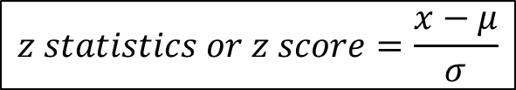
Normal Distribution Components
Standardization
When a frequency distribution is normally distributed but non- ideal i.e. μ is not 0 Or σ is not 1 , we can find out the probability of a score occurring by standardising the scores.

Slide 19
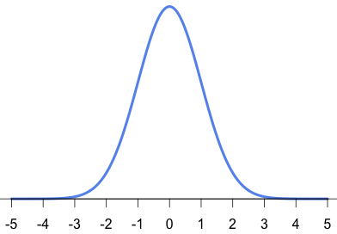
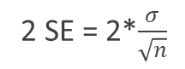
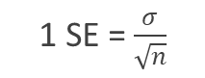



Normal Distribution Components
For Sampling Distribution of means where
mean = μ (population mean)
Std. deviation =σ/√n
68%
95%
This is called margin of error

Slide 20
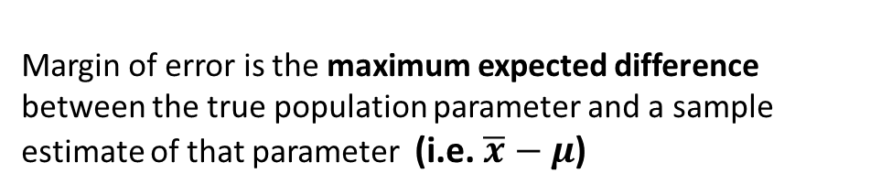


Confidence Interval
Margin of Error gives us confidence to estimate population
Parameter given sample statistics
68%
95%

Slide 21
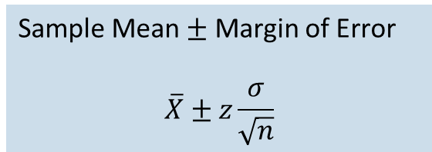
Confidence Interval
Confidence Interval for the Population Mean
Margin of error is meaningful only when stated in conjunction
with a probability (confidence level).
68%
95%

Slide 22


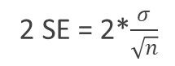


Confidence Interval
Confidence Interval for the Population Mean
68%
95%

Slide 23
Confidence Interval
What is this?
Why is it not here?

Slide 24
Hypothesis Testing and Types

Slide 25
Introduction
Average weight of a indian man is 65 kg

Slide 26
Introduction
What is a Statistical Hypothesis?
“A statistical hypothesis is a statement or claim about a population parameter “
Hypothesis tests give a way of using samples to test whether or not statistical claims about population are likely to be true.
Acceptance or rejection of a claims depends on evidences against claim.
A statistical hypothesis, sometimes called confirmatory data analysis

Slide 27
Types of Hypothesis
Two Types of hypotheses :
H₀: The NULL hypothesis, usually the most conservative.
H₁ or H_{A}: The ALTERNATIVE hypothesis, the one we are actually interested in.
In other words:
Mostly H₁ is considered as the statement supporting our belief in experiment but H₀ is considered as the statement which opposes our belief in experiment.
Both are mutually exclusive.

Slide 28
Types of Hypothesis
Example :
In the National Academy of Archery, the head coach intends to improve the performance of the archers ahead of an upcoming competition.
He proposed and implemented the idea that breathing exercises and meditation before the competition could help.
He performed an experiment and he checked performance before and after experiment:
What Should be Null and Alternate Hypothesis?
“Null Hypothesis”
Mean before and after experiment are similar.
“Alternative Hypothesis”
The after-experiment results are indeed very different from the pre-experiment ones.

Slide 29
Types of Hypothesis
Example :
Null Hypothesis
There is no increase in traffic after website changes
Alternate Hypothesis
There is a increase in traffic after website changes
Null Hypothesis
Coin is fair
Alternate Hypothesis
Coin is biased towards head or tail

Slide 30
Hypothesis Testing Framework

Slide 31
Hypothesis Testing: Framework
Define H0 and H1
Choose right test statistic
Decide level of significance (alpha:α) or critical value
Calculate P Value
Interpretation
Decision
Accept or Reject
1. Compare P-value and α
OR
2. Compare test-statistic and critical value

Slide 32
Define H0 and H1
Define H0 and H1
Choose Right Test Statistic
Level of Significance
Based upon experiment we need to first develop two conditions on population data
First condition should oppose our experiment and should be defined as NULL HYPOTHESIS (H₀)
Second condition should favor our experiment (investigator's belief) and should be defined as ALTERNATIVE HYPOTHESIS (H₁)

Slide 33
Define H0 and H1
Define H0 and H1
Choose Right Test Statistic
Level of Significance
Hypothesis are defined in 3 forms depending upon research question:
Upper-tailed test : In this test an increase is hypothesized
Lower-tailed test : In this test a decrease is hypothesized
Two-tailed test. In this test a difference is hypothesized
H_{0 :}Average weight of a indian man is less than 65 kg
H₀: μ <= μ ₀
H₁: μ > μ ₀
H_{0 :}Average weight of a indian man is more than 65 kg
H₀: μ >= μ ₀
H₁: μ < μ ₀
H₀: μ = μ ₀
H₁: μ ≠ μ ₀
H_{0 :}Average weight of a indian man is 65 kg

Slide 34
Choose right test statistic
Define H0 and H1
Choose Right Test Statistic
Level of Significance
Common Test Statistics for Inferential Techniques:
Inferential techniques (Hypothesis Testing) most commonly use 4 test statistics:
z
t
χ^2 (Chi-squared)
F
Closely related to Sampling Distribution of Means
Closely related to Sampling Distribution of Variances

Slide 35
Choose right test statistic
Choose Right Test Statistic
Choose Right Test Statistic
Level of Significance
Define H0 and H1
Level of Significance
Define H0 and H1
Test statistics are types of tests that should be performed to test our hypothesis. It is based upon following parameters:
Population variance is known or unknown
Sample size
Type of comparison (mean, variance of population/sample)
Number of population to compare

Slide 36
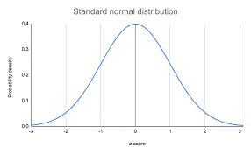
Z-test
Choose Right Test Statistic
Choose Right Test Statistic
Level of Significance
Define H0 and H1
Level of Significance
Define H0 and H1
Z-test is a hypothesis test in which the z-statistic follows a normal distribution
The whole subject matter- inferential statistics is based on the normal distribution.
It is used where
population variance is known.
comparison of mean is required
Size of data is large (>30)

Slide 37
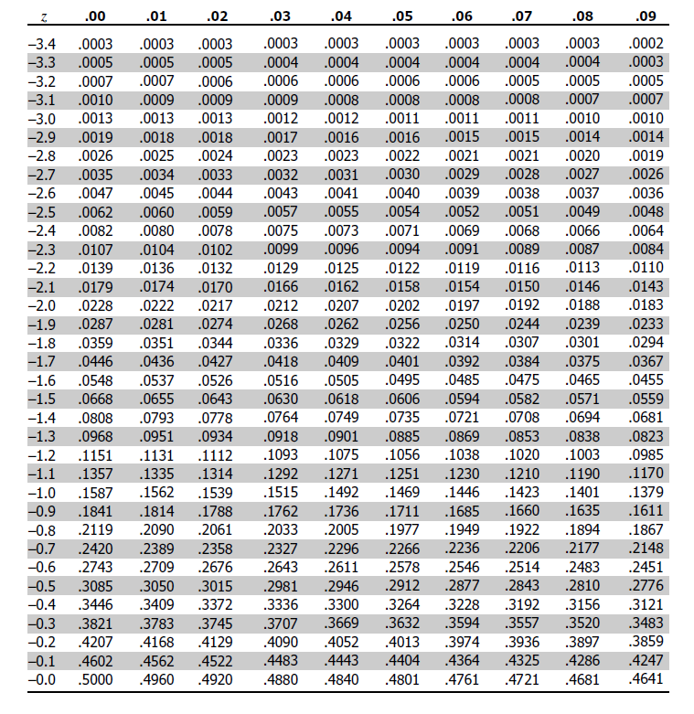
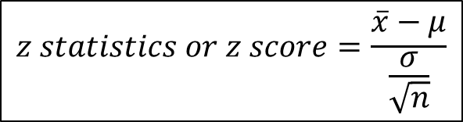
Z-test
Choose Right Test Statistic
Choose Right Test Statistic
Level of Significance
Define H0 and H1
Level of Significance
Define H0 and H1
For a single population
H₀: μ = μ ₀
Probability Distribution table

Slide 38
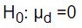
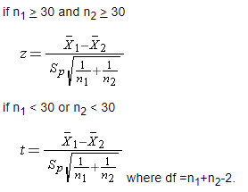
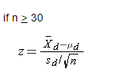
Z – test for 2 samples
Choose Right Test Statistic
Choose Right Test Statistic
Level of Significance
Define H0 and H1
Level of Significance
Define H0 and H1
If samples are independent
If samples are dependent (matched or paired samples)
Two comparison groups are independent or physically separate e.g. group by sex
Data can arise from a single sample of participants where each participant is measured twice (possibly before and after an intervention) or from two samples that are matched on specific characteristics (e.g., siblings)

Slide 39

t-test
Choose Right Test Statistic
Choose Right Test Statistic
Level of Significance
Define H0 and H1
Level of Significance
Define H0 and H1
It is used where
population variance is unknown
comparison of mean is required
Size of data is also small
The t-test is any statistical hypothesis test in which the test statistic follows a Student's t-distribution
Degrees of freedom, ν: # of independent observations for a source of variation minus the number of independent parameters estimated in computing the variation.
When estimating mean from a single sample, the DOF is n-1.

Slide 40
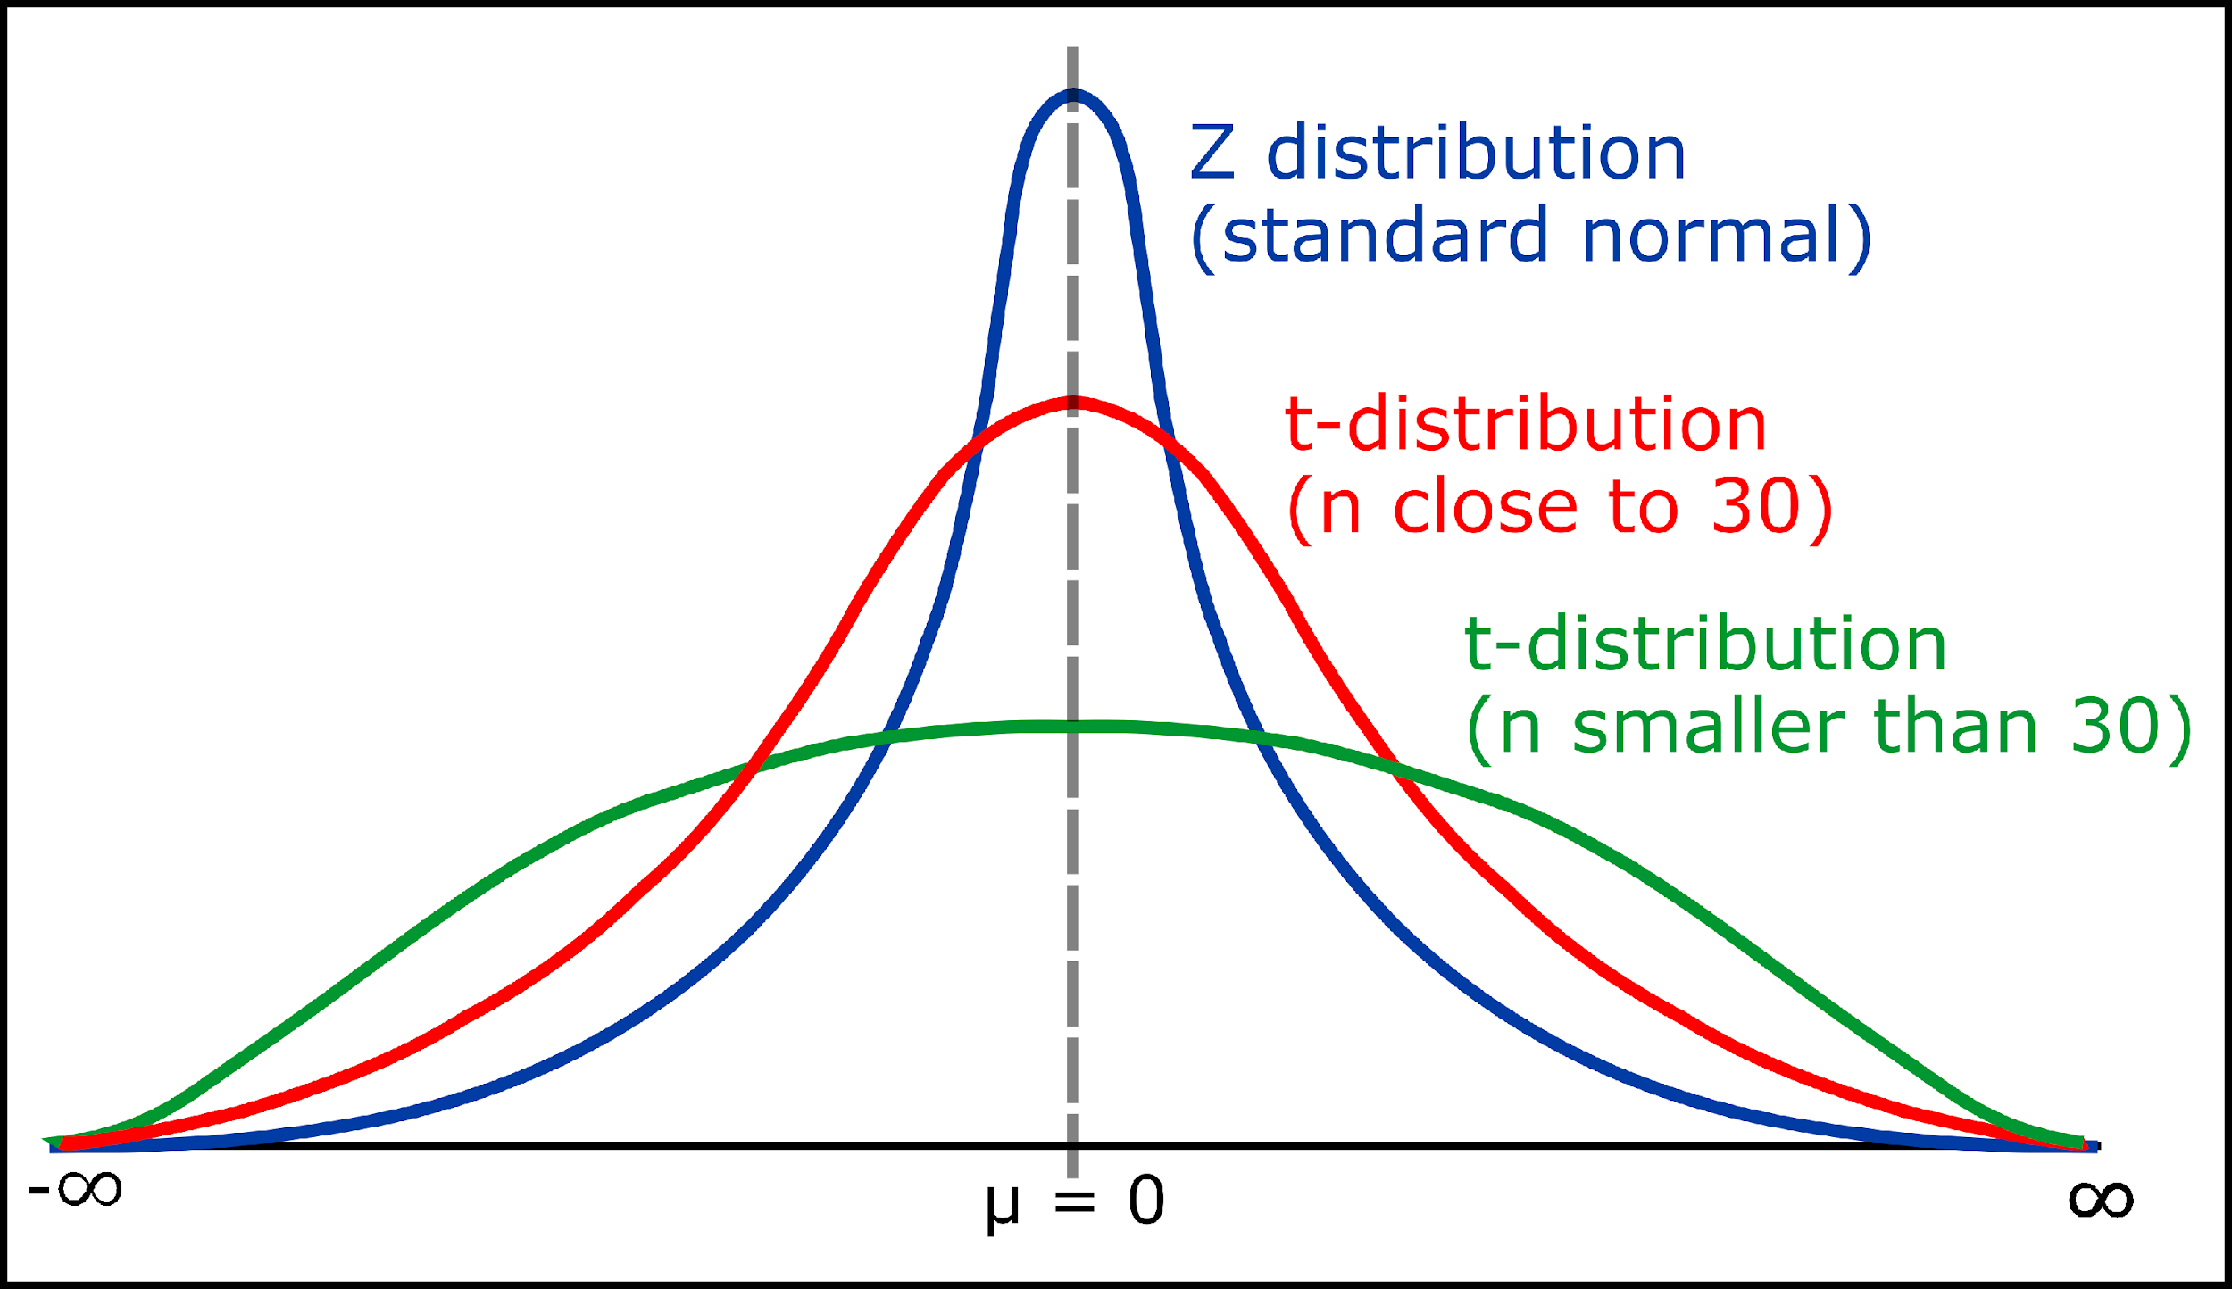
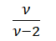
t-test
Choose Right Test Statistic
Choose Right Test Statistic
Level of Significance
Define H0 and H1
Level of Significance
Define H0 and H1
•Mean of the distribution = 0
•Variance = where ν>2
•Variance is always greater than 1, although it is close to 1 when there are many degrees of freedom (sample size is large)
•With infinite degrees of freedom, t distribution is the same as the standard normal distribution

Slide 41
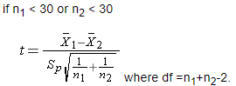
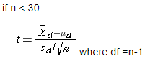
t-test for 2 samples
Choose Right Test Statistic
Choose Right Test Statistic
Level of Significance
Define H0 and H1
Level of Significance
Define H0 and H1
If samples are independent
If samples are dependent (matched or paired samples)
Two comparison groups are independent or physically separate e.g. group by sex
Data can arise from a single sample of participants where each participant is measured twice (possibly before and after an intervention) or from two samples that are matched on specific characteristics (e.g., siblings)

Slide 42

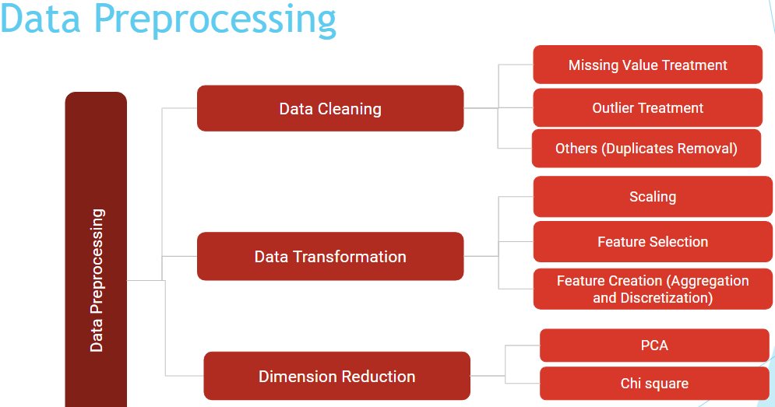
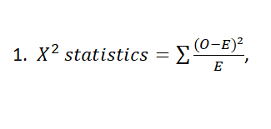
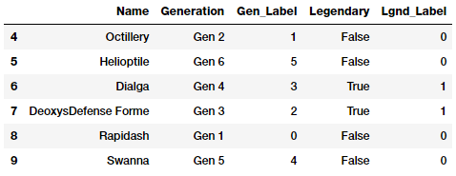
Choose Right Test Statistic
Choose Right Test Statistic
Level of Significance
Define H0 and H1
Level of Significance
Define H0 and H1
It is used where
comparison of variance is required (given 1 population)
check independence of two categorical variables
Chi-Square analysis is widely used in research studies for testing hypothesis involving variance of categorical data.
where O is the observed frequency
and E the expected frequency.
Both are used in different scenarios

Slide 43
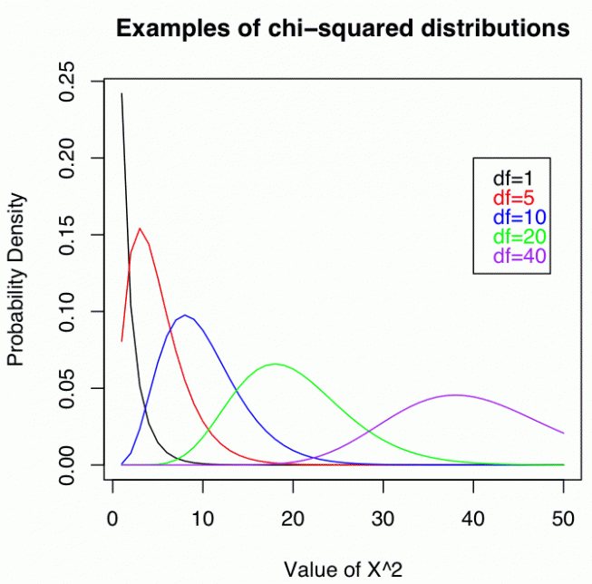
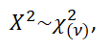
Choose Right Test Statistic
Choose Right Test Statistic
Level of Significance
Define H0 and H1
Level of Significance
Define H0 and H1
where ν represents the degrees of freedom
Increasing the DOF this distribution gradually becomes approximately
normal for large ν.
Degree of Freedom : number of categories - 1

Slide 44
Choose Right Test Statistic
Choose Right Test Statistic
Level of Significance
Define H0 and H1
Level of Significance
Define H0 and H1
Applications of chi square test
To test goodness of fit
Hypothesis testing where observations of any event are compared with proposed probability distribution e.g. to check whether a car arrival at toll station follows Poisson distribution or not.
To test independence of two variables.
Hypothesis testing where we test whether two categorical (nominal) variables are independent on each other e.g. win/lose (results) of a casino machine are dependent on table host or not.
Compare variance of a single population
Hypothesis testing where we compare variance of observations of some event w.r.t. a specific value.

Slide 45
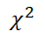
F test
Choose Right Test Statistic
Choose Right Test Statistic
Level of Significance
Define H0 and H1
Level of Significance
Define H0 and H1
was useful in testing hypotheses about a single population variance.
Sometimes we want to test hypotheses about difference in variances of two populations:
Is the variance of 2 stocks the same?
Do parts manufactured in 2 shifts or on 2 different machines or in 2 batches have the same variance or not?

Slide 46
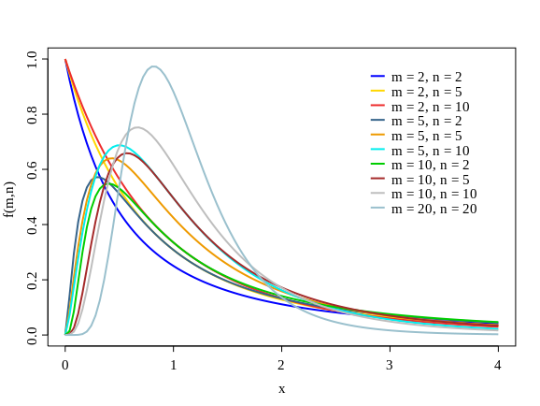

F test
Choose Right Test Statistic
Choose Right Test Statistic
Level of Significance
Define H0 and H1
Level of Significance
Define H0 and H1
Applications of F Distribution
Test for equality of variances.
ANOVA (Analysis of variance).
if the variances are equal, the ratio of the variances will be close to 1.

Slide 47
ANOVA
Choose Right Test Statistic
Choose Right Test Statistic
Level of Significance
Define H0 and H1
Level of Significance
Define H0 and H1
ANOVA (Analysis of Variances) : ANOVA compares the variation between to the variation within groups
This technique is part of the domain called “Experimental Designs”. This helps in establishing in a precise fashion the Cause - Effect relation amongst variables.
Cause : categorical variables
Effect: response variables
Thumb rule to choose ANOVA is when we compare mean of more than 2 population.

Slide 48
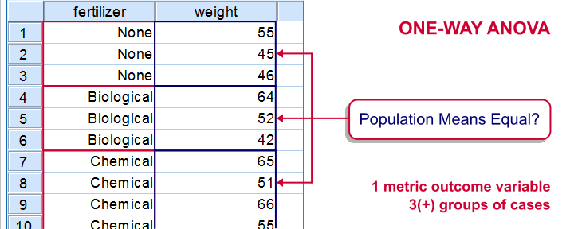
ANOVA
Choose Right Test Statistic
Choose Right Test Statistic
Level of Significance
Define H0 and H1
Level of Significance
Define H0 and H1
e.g. A supermarket is interested in knowing whether it should go for a quarter-page, half-page, or a full-page advertisement for a Product. In order to choose the size of the advertisement that will bring in the most store traffic, the supermarket can use ANOVA technique. We are trying to establish a
cause-effect relationship between store traffic and the various sizes of advertisement.

Slide 49
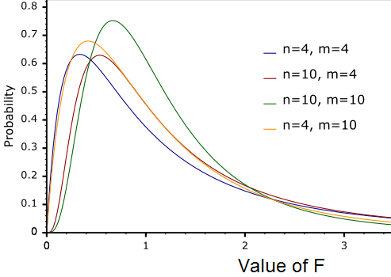
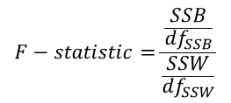
ANOVA
Choose Right Test Statistic
Choose Right Test Statistic
Level of Significance
Define H0 and H1
Level of Significance
Define H0 and H1
The test statistic used is F-statistic.
𝑇𝑜𝑡𝑎𝑙 𝑆𝑢𝑚 𝑜𝑓 𝑆𝑞𝑢𝑎𝑟𝑒𝑠 of variations 𝑊𝑖𝑡ℎ𝑖𝑛 individual group = SSW
𝑇𝑜𝑡𝑎𝑙 𝑆𝑢𝑚 𝑜𝑓 𝑆𝑞𝑢𝑎𝑟𝑒𝑠 variations between group = SSB
degrees of freedom, mn-1=m(n-1)+(m-1)
M = total groups and n = total members in each group

Slide 50
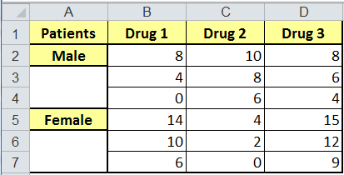
ANOVA
Choose Right Test Statistic
Choose Right Test Statistic
Level of Significance
Define H0 and H1
Level of Significance
Define H0 and H1
Two types of ANOVA are used :
A one-way ANOVA evaluates the impact of a sole factor on a sole response variable.
A two-way ANOVA is an extension of the one-way ANOVA. With a one-way, you have one independent variable affecting a dependent variable. With a two-way ANOVA, there are two independents.
For example, a two-way ANOVA allows a company to compare worker
productivity based on two independent variables, such as salary and
gender. It is utilized to observe the interaction between the two factors
and tests the effect of two factors at the same time.

Slide 51
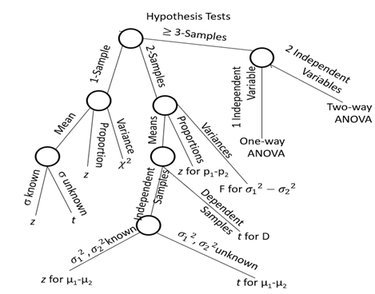
Choose Right Test Statistic
Choose Right Test Statistic
Level of Significance
Define H0 and H1
Level of Significance
Define H0 and H1
Tree Diagram Taxonomy of Inferential Techniques

Slide 52
Decide level of significance
Define H0 and H1
Choose Right Test Statistic
Level of Significance
Average weight of a indian man is 65 kg
(say z value is 60)
At 90% confidence level (10% significance level) it is true
At 95% confidence level (5% significance level) it is false

Slide 53
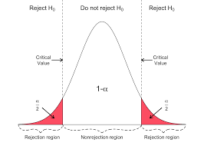
Decide level of significance
Choose Right Test Statistic
Choose Right Test Statistic
Level of Significance
Define H0 and H1
Level of Significance
Define H0 and H1
The significance level (α) is minimum probability that our sample statistics will have,
given H₀ is true. Pmin (statistics/ H₀ True)
In Other words, if probability of sample statistics is lower than significance level then
we consider our null hypothesis to be false and hence we reject it.
It also indicates only α % of the time we make the mistake of rejecting the null
hypothesis when it is true.

Slide 54
Decide level of significance
Choose Right Test Statistic
Choose Right Test Statistic
Level of Significance
Define H0 and H1
Level of Significance
Define H0 and H1
When the value of the level of significance is not specified in a problem, it is a convention to set the value equal to 0.05.
We can also decide critical value of test-statistics based upon alpha. This critical value approach is also used in hypothesis testing. It is compared against test-statistics

Slide 55
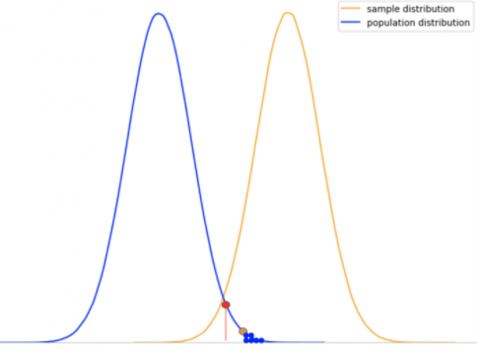
Determine P Value
Choose Right Test Statistic
Compare Values
Level of Significance
Define H0 and H1
Decision and Interpretation
Calculate P value
p value is used in hypothesis testing to help you support or reject the null hypothesis.
The p value is the evidence for a null hypothesis. It shows that how
probable are my sample results similar to claims made in null hypothesis.
It is the probability of getting the current results from sample
being null hypothesis is true.
P (statistics/ H₀ True)
Or
Simply, The smaller the p-value, the stronger the evidence that you should reject the null hypothesis.

Slide 56
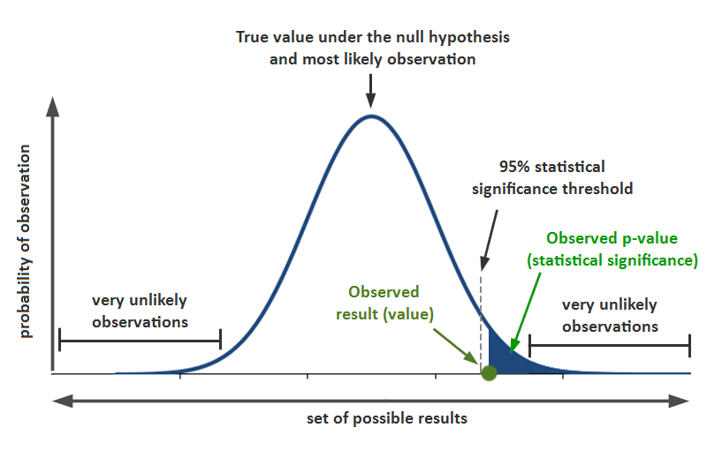
Determine P Value
Choose Right Test Statistic
Choose Right Test Statistic
Compare Values
Level of Significance
Level of Significance
Define H0 and H1
Decision and Interpretation
Define H0 and H1
Calculate P value
1. Calculate test – statistics based upon type of test that we have chosen
2. If test requires degree of freedom, find DOF for test
3. Use respective probability distribution table for chosen test
and determine p-value based upon sample-statistics.

Slide 57
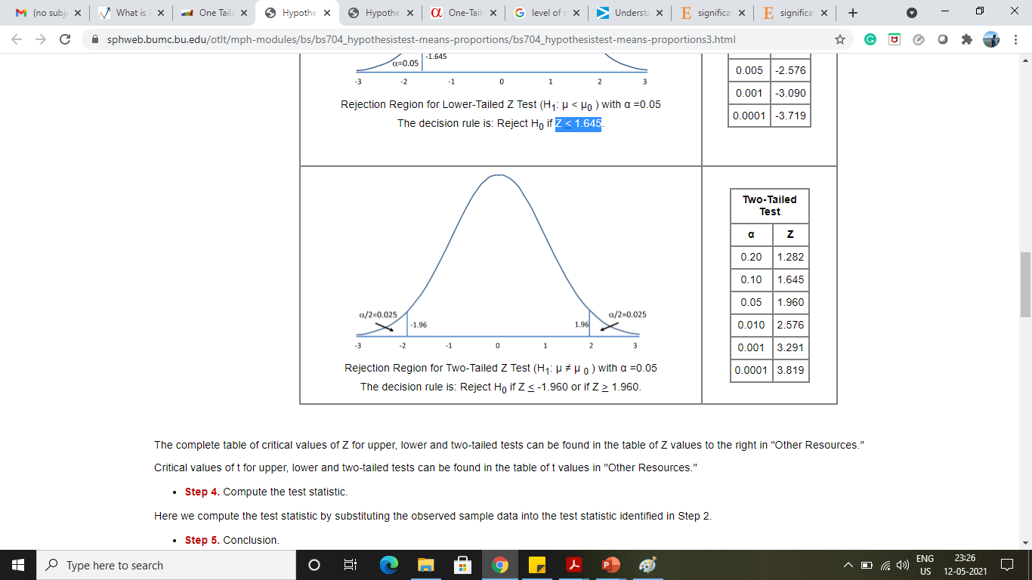
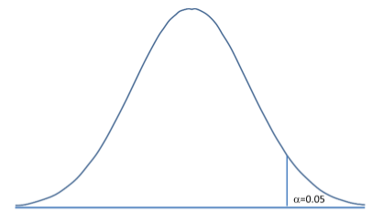
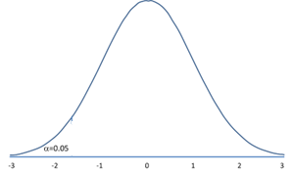
Determine P Value
Choose Right Test Statistic
Choose Right Test Statistic
Compare Values
Level of Significance
Level of Significance
Define H0 and H1
Decision and Interpretation
Define H0 and H1
Calculate P value
P- value
p-value determination differs for upper tail , lower tail and two-tailed test
Upper-tailed test
find the probability that Z is greater than your test statistic
Lower-tailed test
find the probability that Z is less than your test statistic
Two-tailed test
find the probability that Z is beyond your test statistic and double it
H₀: μ <= μ ₀
H₀: μ >= μ ₀
H₀: μ = μ ₀

Slide 58
Comparison of results
Choose Right Test Statistic
Compare Values
Level of Significance
Define H0 and H1
Decision and Interpretation
Calculate P value
P-value approach : Compare p value to alpha
critical-value approach : Compare test static value to critical value

Slide 59
Decision Making
Choose Right Test Statistic
Compare Values
Level of Significance
Define H0 and H1
Decision and Interpretation
Calculate P value
P-value approach : if p value is less than level of significance
than reject the null hypothesis else do not reject
null hypothesis.
critical-value approach : Depends on type of test we need to
decide rejection or acceptance of null hypothesis.

Slide 60
Decision Making
Choose Right Test Statistic
Compare Values
Level of Significance
Define H0 and H1
Decision and Interpretation
Calculate P value
Upper-tailed test
Rules for rejections
(Considering z test , alpha = 0.05
and critical value = 1.645)
Reject H₀ if Z > 1.645
Reject H₀ if p < 0.05

Slide 61
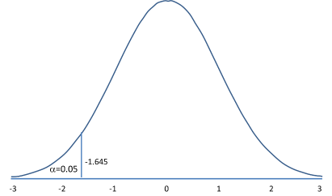
Decision Making
Choose Right Test Statistic
Compare Values
Level of Significance
Define H0 and H1
Decision and Interpretation
Calculate P value
Lower-tailed test
Rules for rejections
(Considering z test , alpha = 0.05 and critical value = 1.645)
Reject H₀ if Z < -1.645
Reject H₀ if p < 0.05

Slide 62
Decision Making
Choose Right Test Statistic
Compare Values
Level of Significance
Define H0 and H1
Decision and Interpretation
Calculate P value
Two-tailed test
Rules for rejections
(Considering z test , alpha = 0.05 and critical value = 1.645)
Reject H₀ if Z < -1.960 or if Z > 1.960
Reject H₀ if p < 0.025 or (α/2)

Slide 63
Interpretation
Choose Right Test Statistic
Compare Values
Level of Significance
Define H0 and H1
Decision and Interpretation
Calculate P value
Reject Null hypothesis :
If evidences are not enough to accept null hypothesis at given
confidence level then we reject null hypothesis . We also say that
results obtained are statistically significant.
“The results obtained from the sample is an extremity
of the population distribution (an extremely rare event),
and hence there is a good chance it may belong to some
other distribution (as shown below).”

Slide 64

Interpretation
Choose Right Test Statistic
Compare Values
Level of Significance
Define H0 and H1
Decision and Interpretation
Calculate P value
Fail to reject Null hypothesis :
If evidences are enough at given confidence level then we fail to reject null hypothesis .
We also say that results obtained are not significant.
“obtained results are more likely to be part of the same
population distribution than being a part of some other
distribution.”

Slide 65
Example

Slide 66
Examples : Two tail test
The manufacturer of a certain brand of car batteries claims that mean life of these batteries is 45 months.
A consumer protection agency that wants to check this claim took a random sample of 24 such batteries and found that the mean life for this sample is 43.05 months. The lives of all such batteries have a normal distribution with the population standard deviation of 4.5 months.
Test the manufacturer’s claim at the 0.05 degree of significance

Slide 67
Examples : Two tail test
First Define H₀ and H₁
Two tailed test
H₀: μ = 45
H₁: μ ≠ 45

Slide 68


Examples : Two tail test
Define right test statistics
Comparison of mean for 1 population (t- test / z-test)
Population variance is known (z-test, normal distribution)
Decide level of significance / Critical value
Alpha = 0.05
Critical value = +1.96 / -1.96 (z value at p = 1-α/2)
Non- Rejection Region
Rejection Region
α/2 = 0.025
Rejection Region
α/2 = 0.025
Rejection Region
α/2 = 0.025
z = -1.96
z = 1.96
z = 1.96

Slide 69

Examples : Two tail test
Decide level of significance / Critical value
α/2 = 0.025
Critical value = 1.96

Slide 70

Examples : Two tail test
Determine P Value
Test statistic
Non- Rejection Region
z = -2.12
z = 2.12

Slide 71
Examples : Two tail test
Decision Making
Reject H₀
Z = -2.12 < -1.960
p = 0.0170 < 0.025
There is no enough evidence supporting claim about mean life of these batteries as 45 months.
Hence We reject company claim.

Slide 72
Examples : 1 tail test
The food company claims average durability of a packed food is >= 2 days. A engineer believes that this should be less than that.
Using 10 samples he checks and finds that average expiry of that product is 1.8 days with a standard deviation of 0.15.
Can you check that at 99% confidence interval engineer has enough evidence to discard claim of company.

Slide 73
Examples : 1 tail test
First Define H₀ and H₁
Lower tailed test
H₀: μ >= 2
H₁: μ < 2

Slide 74


Examples : 1 tail test
Define Right Test Statistic
Comparison of mean for 1 population (t- test / z-test)
Population variance is unknown (t-test)
Decide level of significance / Critical value
Alpha = 0.01
Critical value = -2.82 (t value at p = 0.01 and DOF = 9)
Rejection Region
α = 0.01
t = -2.82

Slide 75

Examples : 1 tail test
Decide level of significance / Critical value
Alpha = 0.01
Critical value = -2.821
Rejection Region
α = 0.01

Slide 76

Examples : 1 tail test
Determine P Value
P value = 0..00112
t = -4.22

Slide 77
Examples : 1 tail test
Decision Making
Reject H₀
t = -4.2 < -2.88
p = 0.00112 < 0.01
There is no enough evidence supporting claim about mean durability of packaged food more than 2 days.
Hence We reject manager’s claim.

Slide 78

Examples : Goodness of Fit
This test is used whenever you have a set of values that should fit a distribution, and you want to test whether the data actually follow that distribution or not.
χ^2 distribution uses a test statistic to look at the difference between the expected and the actual probability distribution
where O is the observed frequency and E the expected frequency.

Slide 79
Examples : Goodness of Fit
Let us say you are running a casino and the slot machines are causing you headaches. You had designed them with the following expected probability distribution, with X being the net gain from each game played.
x | -2 | 23 | 48 | 73 | 98
P(X=x) | 0.977 | 0.008 | 0.008 | 0.006 | 0.001

Slide 80
Examples : Goodness of Fit
You collected some statistics and found the following frequency of peoples’ winnings.
You want to compare the actual frequency with the expected frequency.
Are these differences significant?
x | -2 | 23 | 48 | 73 | 98
Frequency | 965 | 10 | 9 | 9 | 7

Slide 81
Examples : Goodness of Fit
First Define H₀ and H₁
H₀: The slot machine winnings per game follow the described probability distribution, i.e., they are not rigged.
H₁: The slot machine winnings per game do not follow this distribution.

Slide 82

Examples : Goodness of Fit
Define Right Test Statistic
Therefor there are 5-1=4 degrees of freedom.

Slide 83


Examples : Goodness of Fit
Decide level of significance / Critical value
One-tailed test using the upper tail of the distribution as the critical region.

Slide 84


Examples : Goodness of Fit
Decide level of significance / Critical value

Slide 85

Examples : Goodness of Fit
x | O | E | O-E
-2 | 965 | 977 | -12
23 | 10 | 8 | 2
48 | 9 | 8 | 1
73 | 9 | 6 | 3
98 | 7 | 1 | 6

Slide 86

Examples : Goodness of Fit
Decision Making
Reject H₀
9.488
38.272
There is sufficient evidence to reject the hypothesis that the slot machine winnings follow the described probability distribution.

Slide 87
Errors

Slide 88


Slide 89
Errors
What if we do not conclude our results accurately ?
Reasons might be anything from lack of evidences, selection of incorrect test-statistics etc.
It might lead to a wrong conclusion about null hypothesis and alternative hypothesis
Type I error: We reject the NULL hypothesis incorrectly
Type II error: We “accept” it incorrectly

Slide 90
Errors
 |  | State of Nature (Actual)
 |  | Null true | Null false
Action | Fail to reject null (negative) | Correct decision True Negative Specificity P(Accept H₀ | H₀ True) | Type II error (β) False Negative P(Accept H₀ | H₀ False)
 | Reject null (positive) | Type I error (α) False Positive P(Reject H₀ | H₀ True) | Correct decision (Power) True Positive Sensitivity/Recall P(Reject H₀ | H₀ False)

Slide 91
Errors
Two cases of correct decision
Accept null hypothesis when it is True
(True Negative Rate)
2. Reject null hypothesis when it is false
(True positive rate)
Power = 1 – FNR(β)
 |  | State of Nature (Actual)
 |  | Null true | Null false
Action | Fail to reject null (negative) | Correct decision True Negative Specificity P(Accept H₀ | H₀ True) | Type II error (β) False Negative P(Accept H₀ | H₀ False)
 | Reject null (positive) | Type I error (α) False Positive P(Reject H₀ | H₀ True) | Correct decision (Power) True Positive Sensitivity/Recall P(Reject H₀ | H₀ False)

Slide 92
Errors
Example:
H₀ : There is no improvement in health from new drug
H₁ : There is a significant improvement in health from new drug
Type I error you conclude that the drug intervention improved symptoms when it actually didn’t. These improvements could have arisen from other random factors or measurement errors.
Type II error you conclude that the drug intervention didn’t improve symptoms when it actually did.

Slide 93
Errors
Consequences of errors
H₀ : There is no improvement in health from new drug
H₁ : There is a significant improvement in health from new drug
Type I error Based on the incorrect conclusion that the new drug intervention is effective, over a million patients are prescribed the wrong medication, despite risks of severe side effects and inadequate research on the outcomes.
Type II error This means that a medication with important clinical significance doesn’t reach a large number of patients who could tangibly benefit from it.

Slide 94

Errors
P(Type I error) = α
Probability of Getting Type I Error
α

Slide 95

Errors
Probability of Getting Type II Error

Slide 96
Errors
How to increase power of my test
1.Reduce α
2.Reduce SE (σ/√n) by increasing sample size
3.Reduce SE (σ/√n) by decreasing variation
Probability of Getting Type II Error
Limitations:
1.Reduce α (it will increase type 1 error as well)
2.Reduce SE (σ/√n) by increasing sample size
( it is under control )
3.Reduce SE (σ/√n) by decreasing variation (it is not under control)

Slide 97

Errors
Calculation : Probability of Getting Type II Error
This is a left tailed test
We will fail to reject the null (commit a Type II error) if we get a Z statistic less than -1.64.

Slide 98


Errors
Calculation : Probability of Getting Type II Error

Slide 99



Errors
Calculation : Probability of Getting Type II Error
What we would like to now is calculate the probability of a Type II error conditional
on a particular value of µ
Lets assume that µ = 26 , but we could choose any
value assuming alternative is correct.

